Slide 1

OpenStreetMap: an introduction

Slide 2
Who am I?
Studied informatics
Heavy OSM-contributor
Works on a website to make contributing to OSM easier
Formerly worked for a small company on mobility (with OSM)

Slide 3
Contents
OpenStreetMap.org is...
… a database
… freedom to add data
… Open Source/Open data
… many applications
… a community

Slide 4
What is
OpenStreetMap?

Slide 5

A Database:
Geospatial data
Lines and dots
+
Some information
on each line and dot

Slide 6

Tags (attributes)

Slide 7

Tags (attributes)

Slide 8

Tags (attributes)
The property we are describing (Key)
The value of the property
(Value)

Slide 9
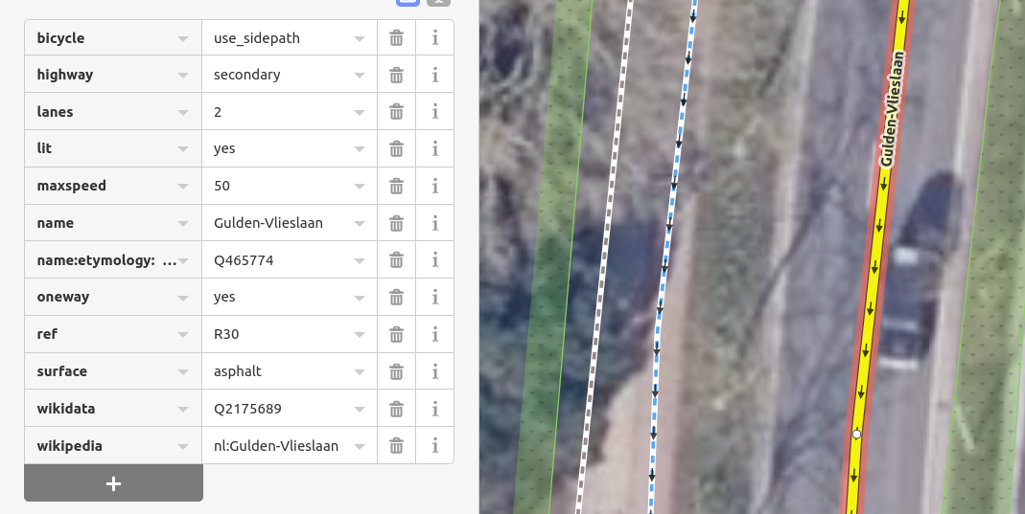
Tags (attributes)

Slide 10
Euhm…
I don’t know any of those tags
A tremendous lot is known by the editor
Something special: have a look on wiki.osm.org
Ask the community (of the country where you are mapping)
Still no answer? Invent something, in collaboration with the community

Slide 11
Freedom to add data

Slide 12
A Database:
Geospatial data
Lines and dots
+
Some information
on each line and dot

Slide 13
Dataflow
small changes
OpenStreetMap.org Database
t
Contributors

Slide 14
Dataflow
OpenStreetMap.org Map
t
small changes
OsmAnd app
OpenStreetMap.org Database
t
t
overpass-turbo.eu
t
t
researchers
t
Contributors
t
Wikipedia
t
Pokemon Go
….....
….

Slide 15
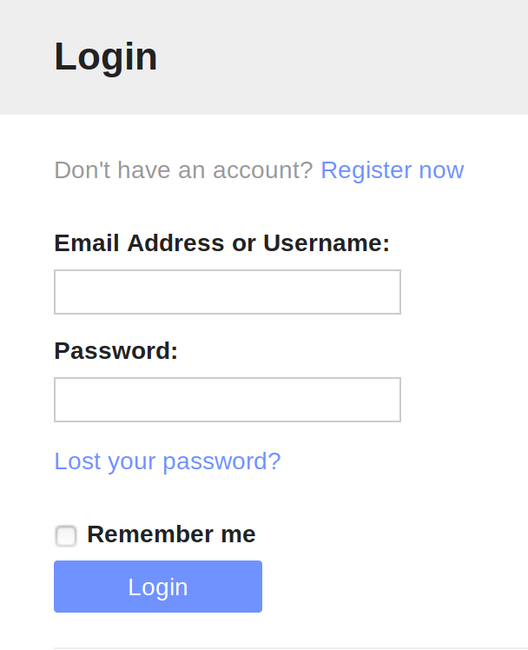
Creating an account

Slide 16
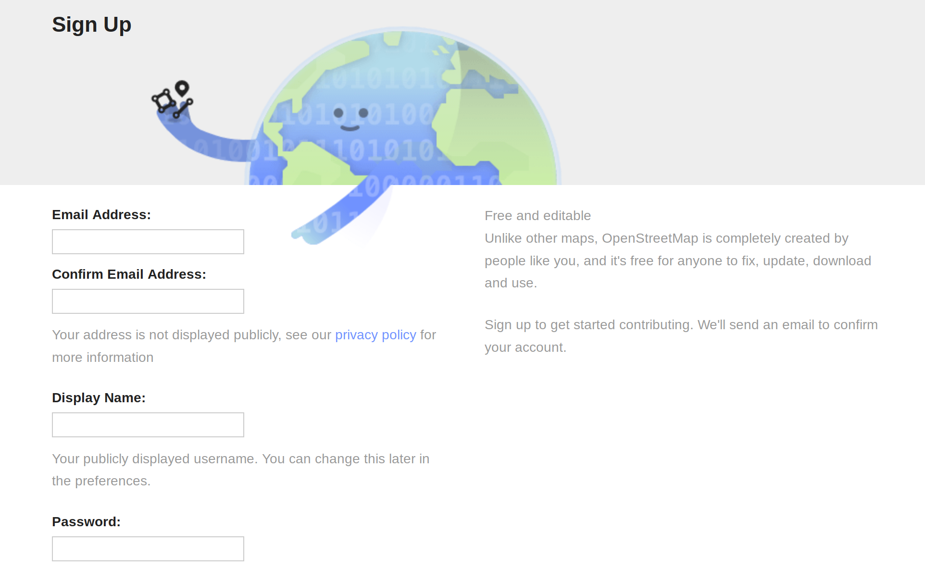
Creating an account

Slide 17


Creating an account

Slide 18
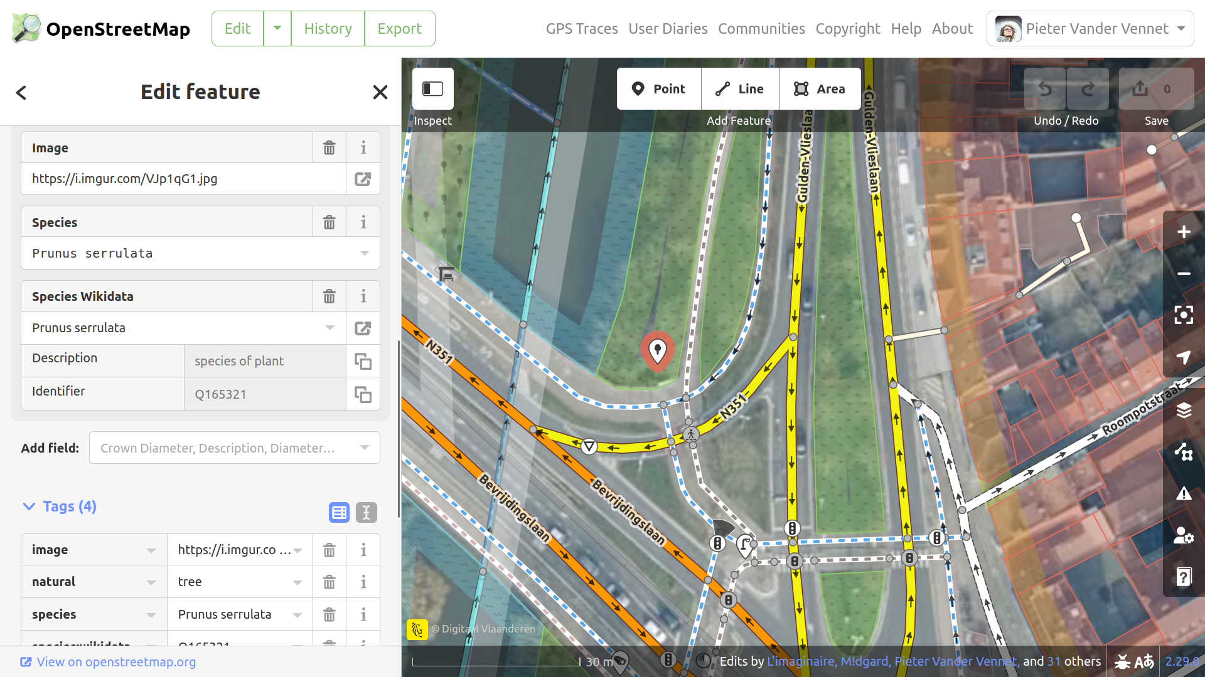
Tags (attributes)

Slide 19
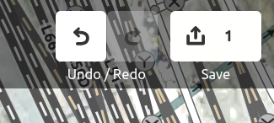
Editing
While editing on osm.org:
don’t forget to click ‘save’ to actually upload.
This creates a ‘changeset’ (~commit)

Slide 20
Freedom to add data

Slide 21
Freedom to add data
As long as it is verifiable on the ground
As long as it is somewhat permanent
As long as no copyright is infringed
Go add your specific needs!

Slide 22
Freedom of software
28
active pieces of software
to edit OpenStreetMap with
as of dec ‘20
(and around 15 deprecated)

Slide 23
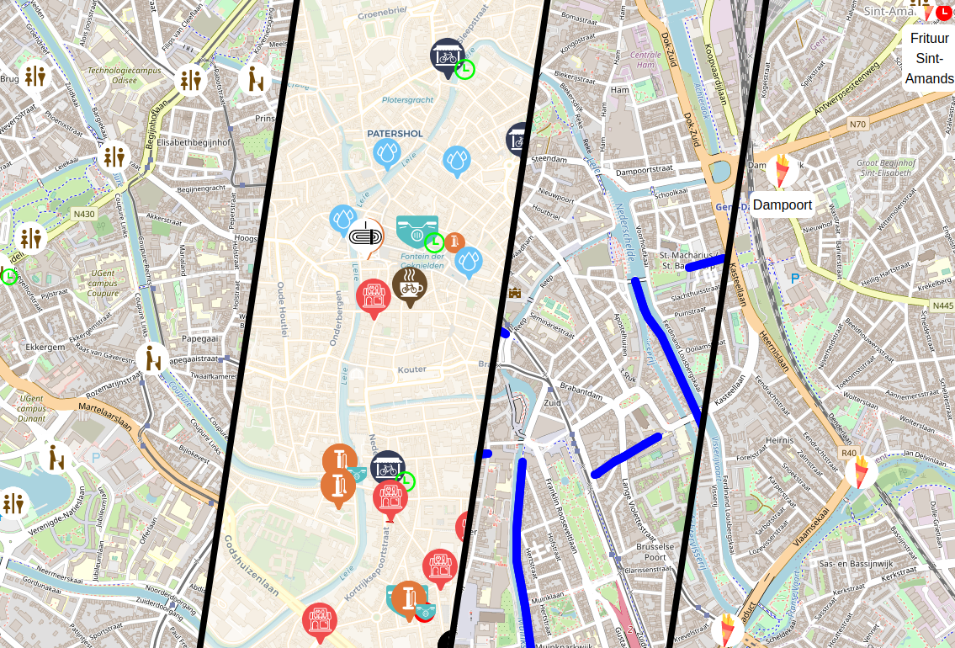
MapComplete.org

Slide 24
MapComplete.org
Developed by me
Many views about a single topic, showing relevant POI
Shows known attributes, questions about unkown attributes
Has reviews, images, wikidata-integration, Mapillary, favourites, ...

Slide 25
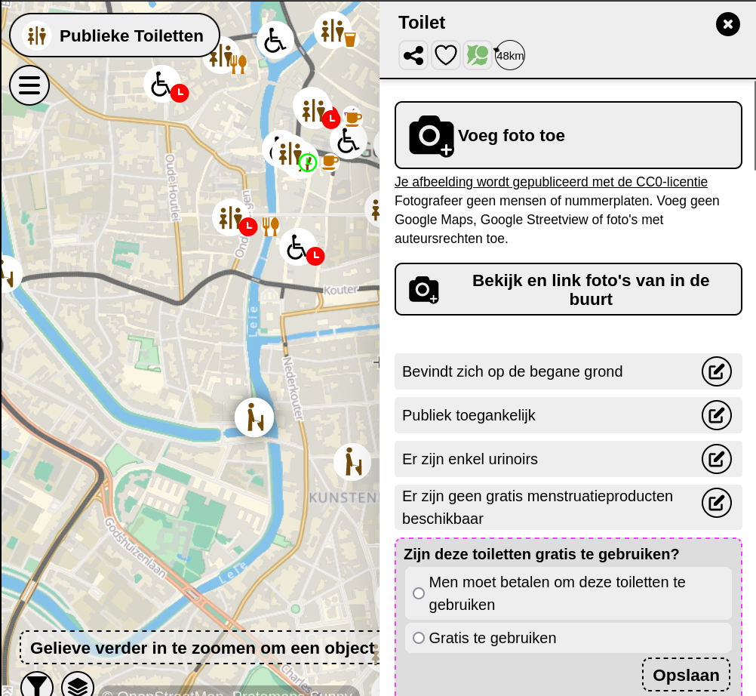

Slide 26
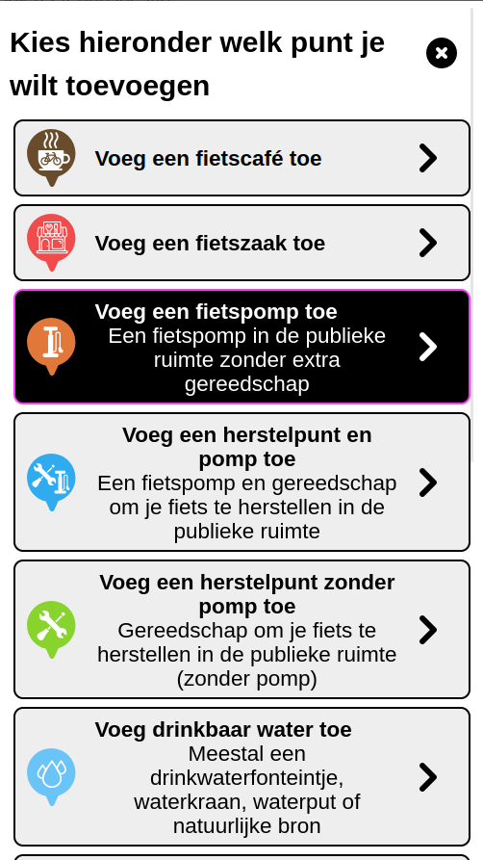
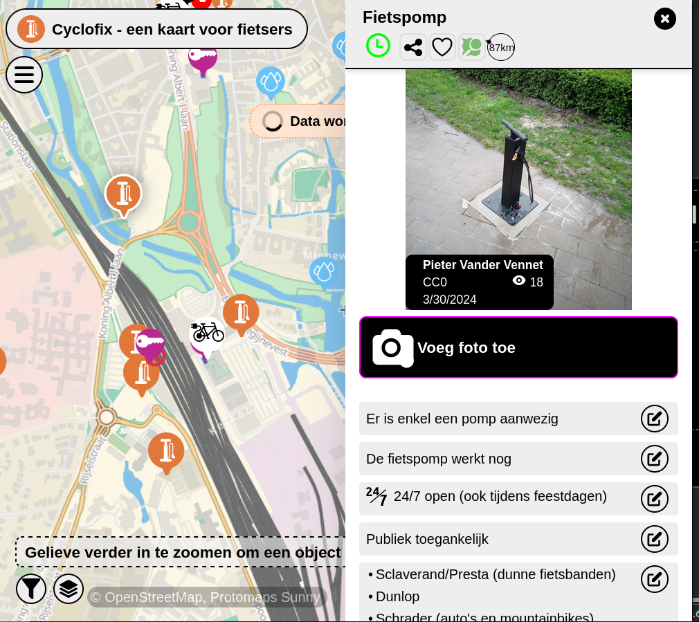

Slide 27
What is
OpenStreetMap?

Slide 28
Open Source
&
Open Data

Slide 29
What is Free Software (~“Open Source”)
A computer program where the author granted everyone the right to:
(Re)use the software as you see fit
Inspect the source code
Modify the source code and distribute that
Not necessarily gratis – e.g. paying for a compiled version
There might be restrictions (e.g. attribution, changes you make are open source too)

Slide 30
Why is free software better?
Better quality software
If the original author goes rogue/dissappears/… others can take it over and make alternative version of it (forks)
Respects the users more
Less concentration of power with a few multinationals

Slide 31

The license: ODbL
Open Database License
You can use the data how you like
as long as you give attribution
and keep the data open

Slide 32
Many tools and applications

Slide 33
Tons of apps, tools and websites, ...
Big and sometimes confusing ecosystem
Many usecases
Tools and businesses grow (and sometimes die)
An overview of the most important ones are here

Slide 35


Slide 36


Slide 37


Slide 38


Slide 39


Slide 40


Slide 41


Slide 42
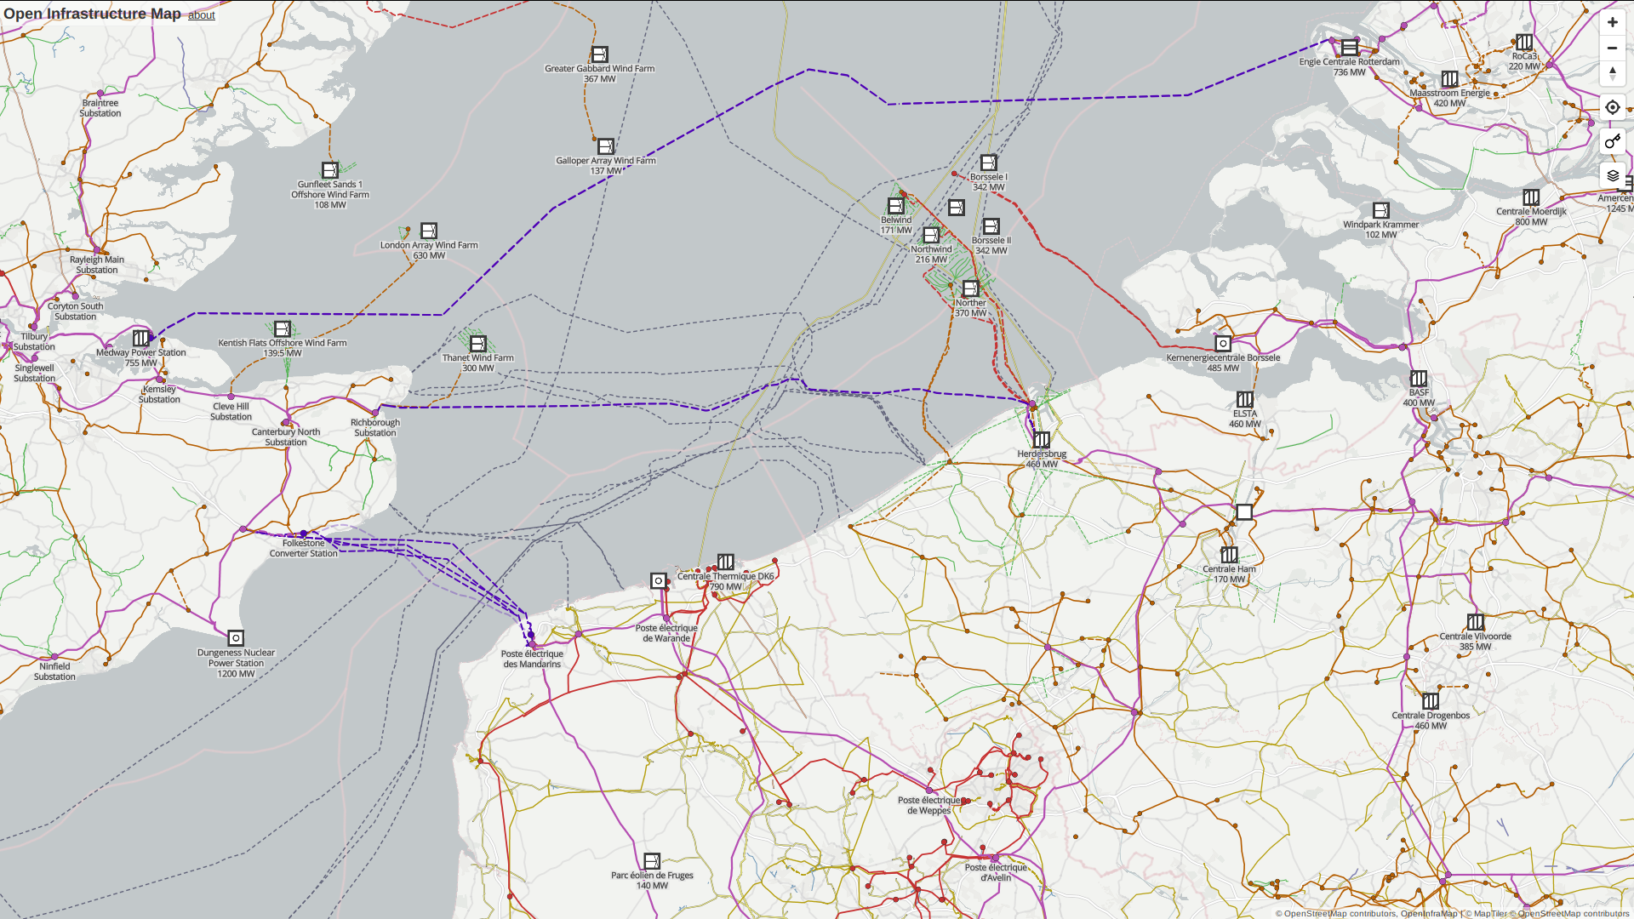

Slide 43
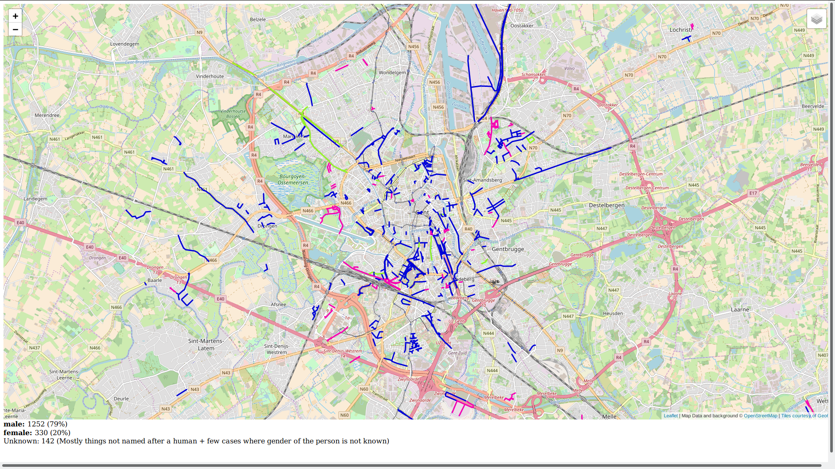


Slide 44
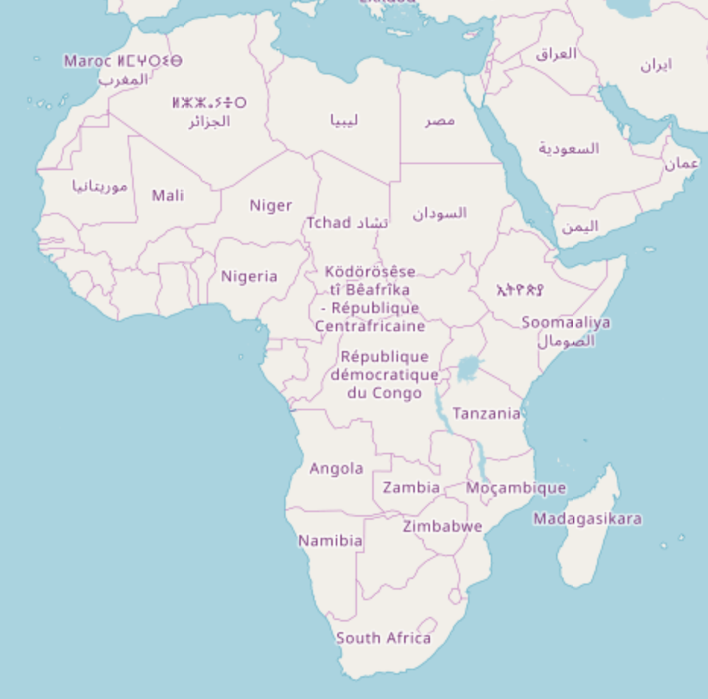

Slide 45


Slide 46



Slide 47




OsmAnd

Slide 48
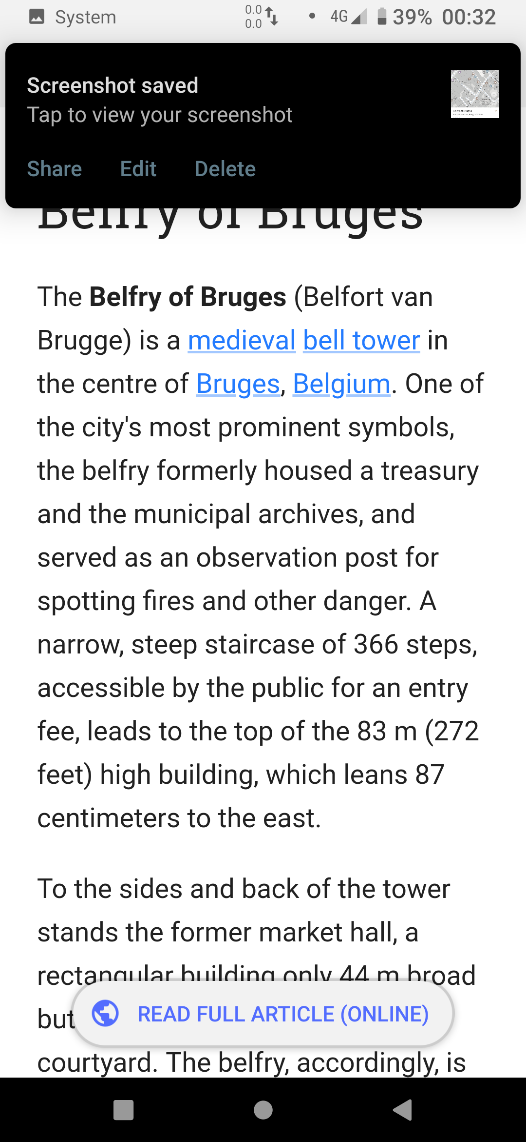
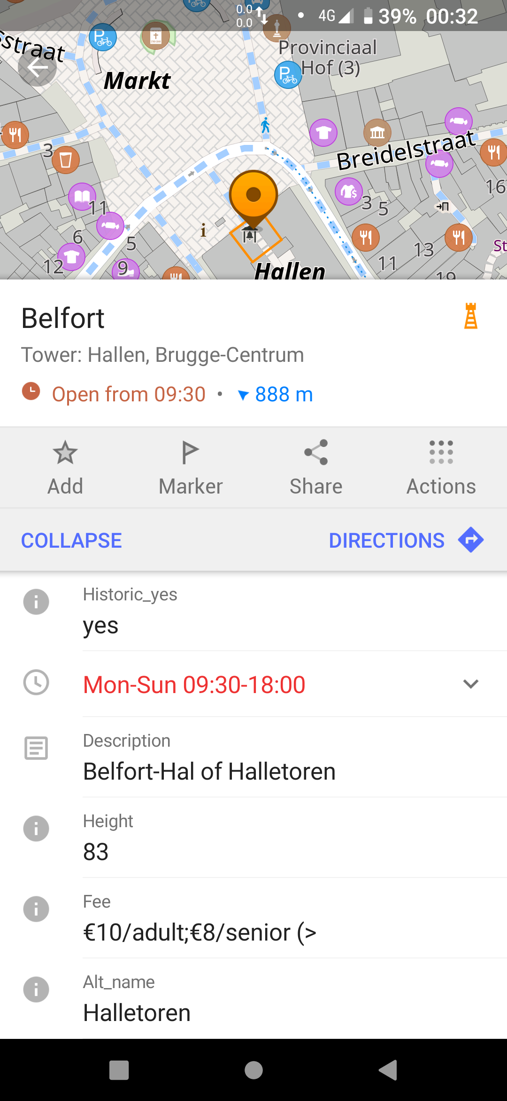
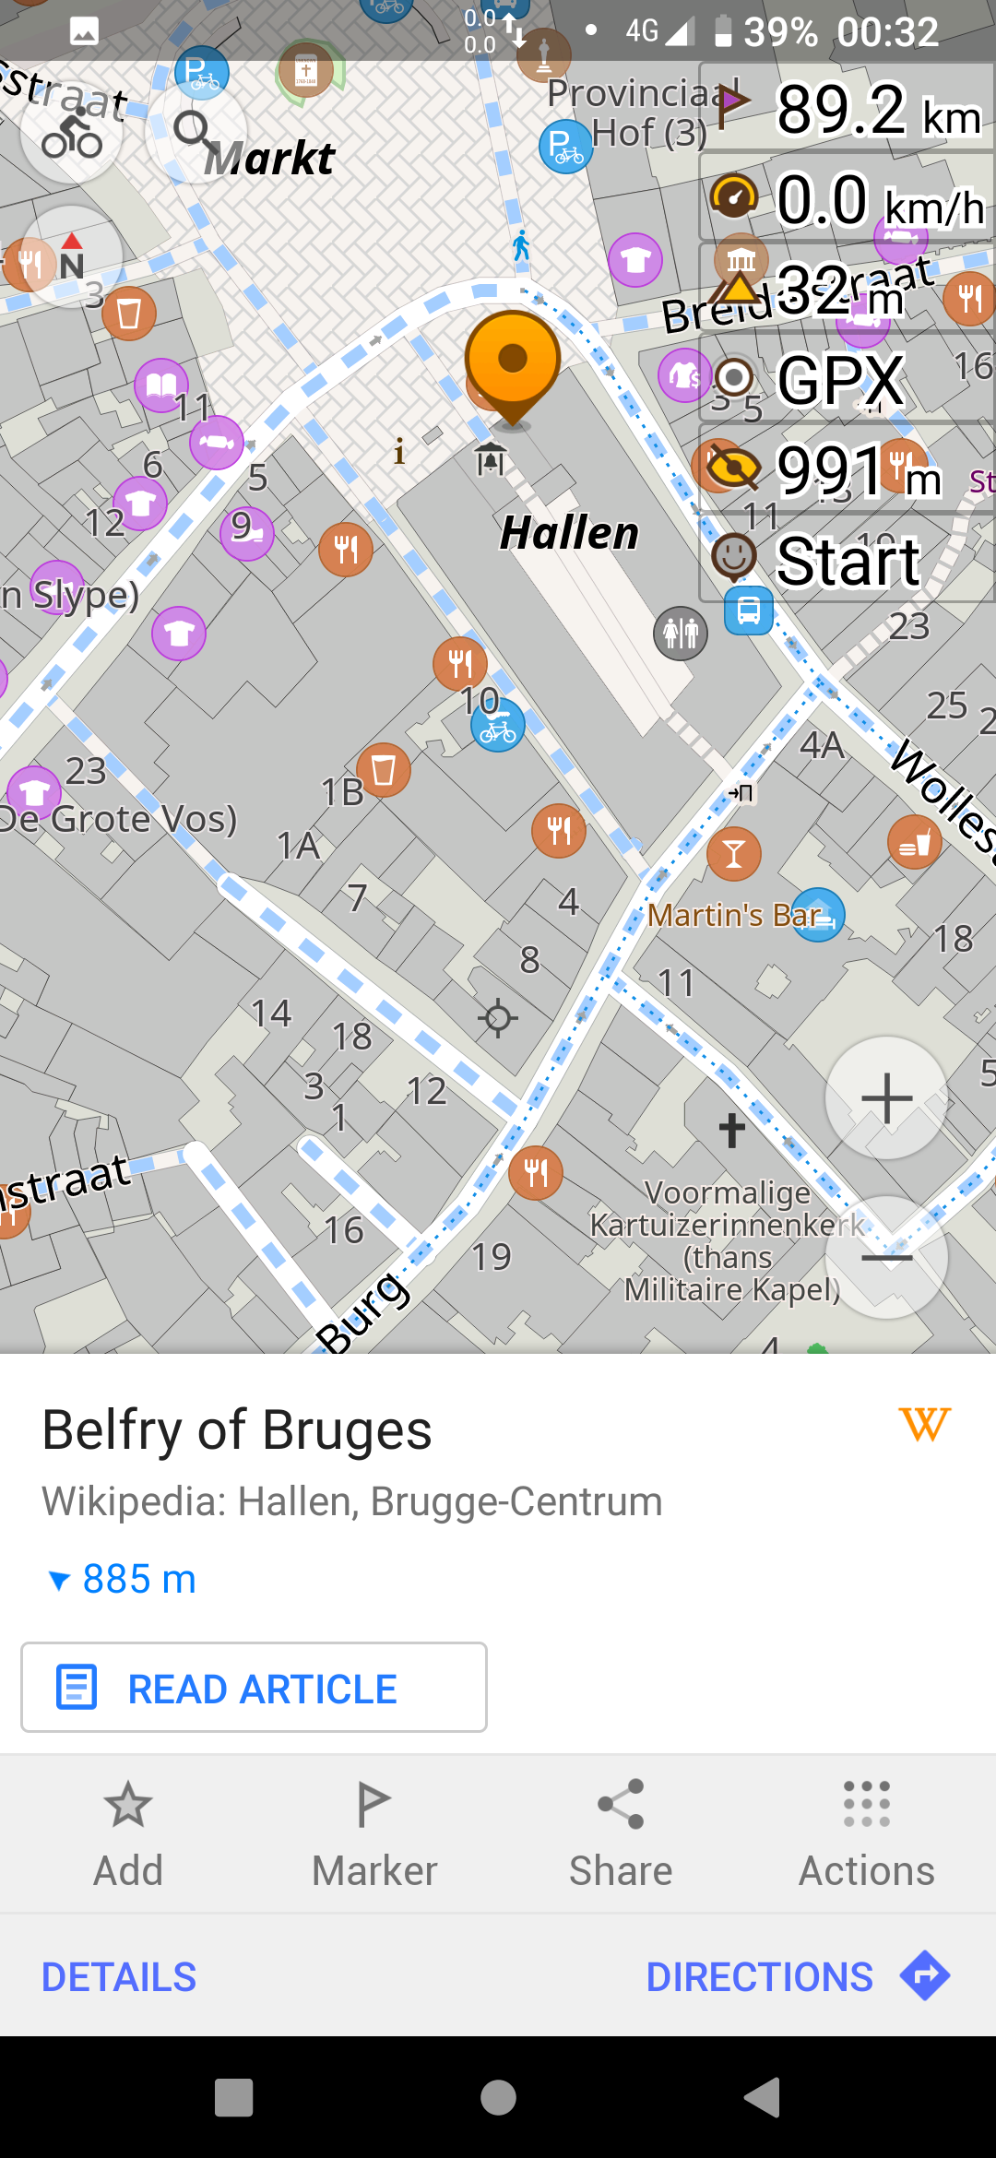

OsmAnd

Slide 49
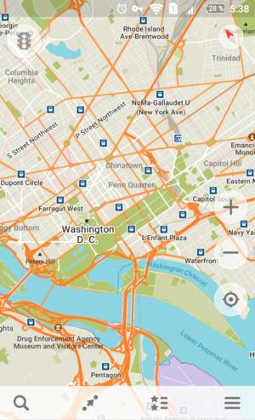
Organic Maps

Slide 50
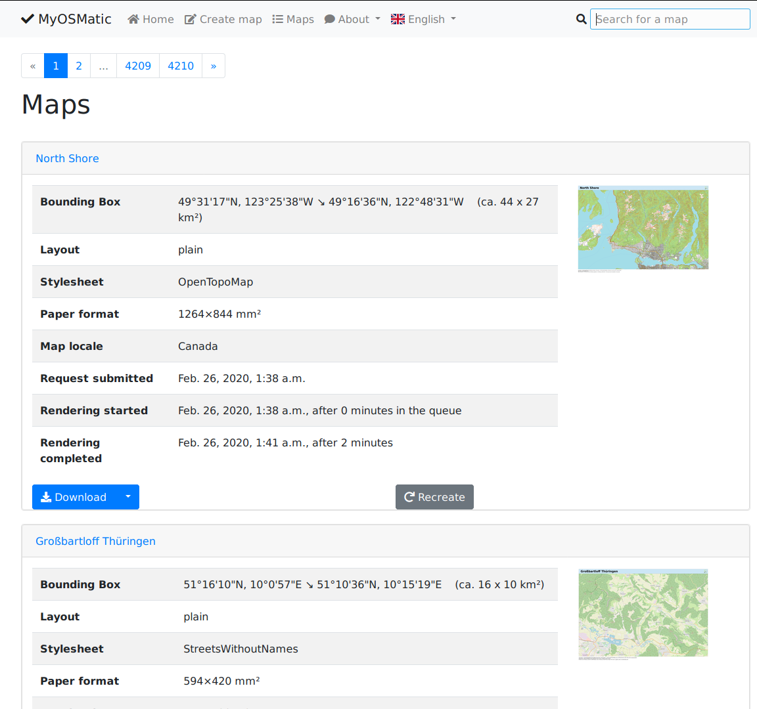
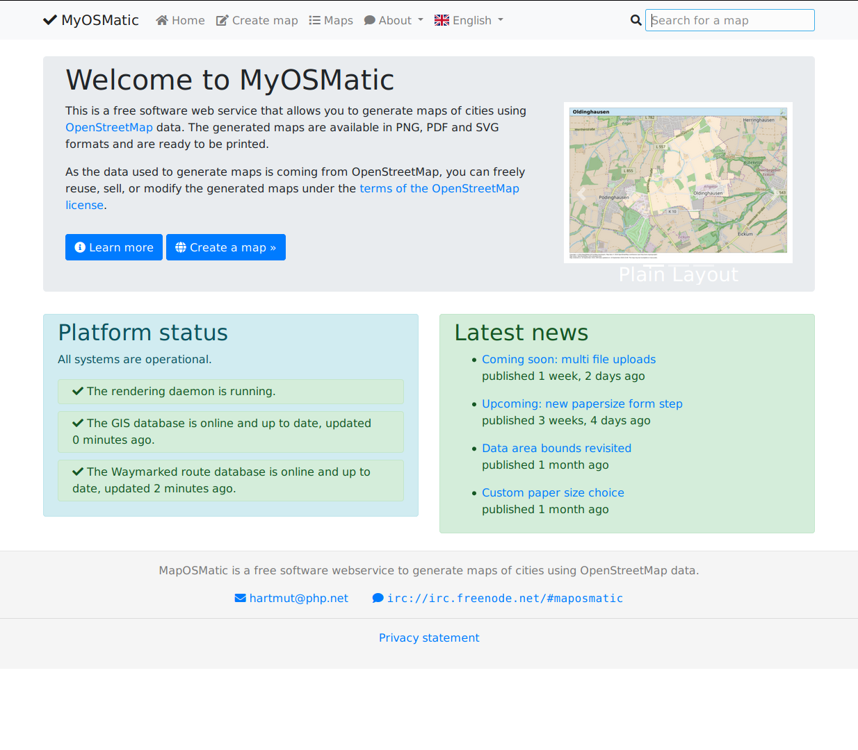
On paper: maposmatic

Slide 51
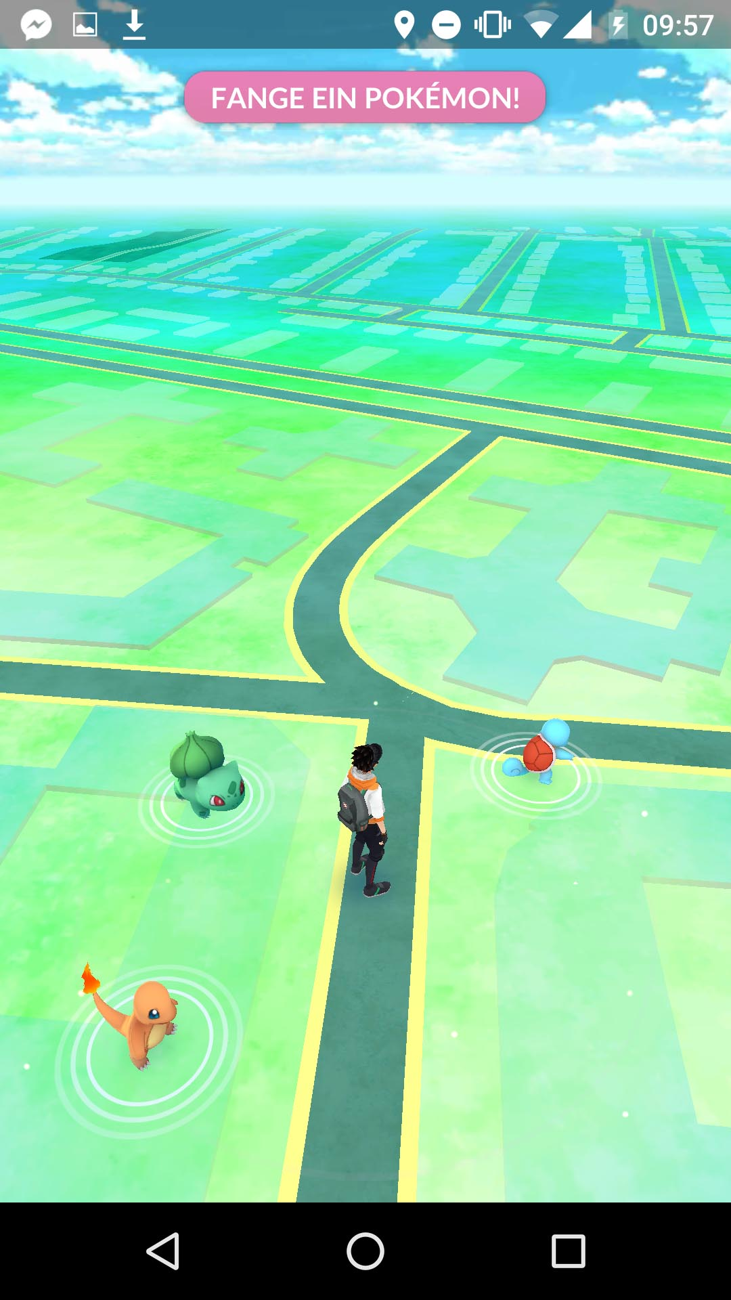

Slide 52

https://demo.f4map.com

Slide 53

https://demo.f4map.com

Slide 54
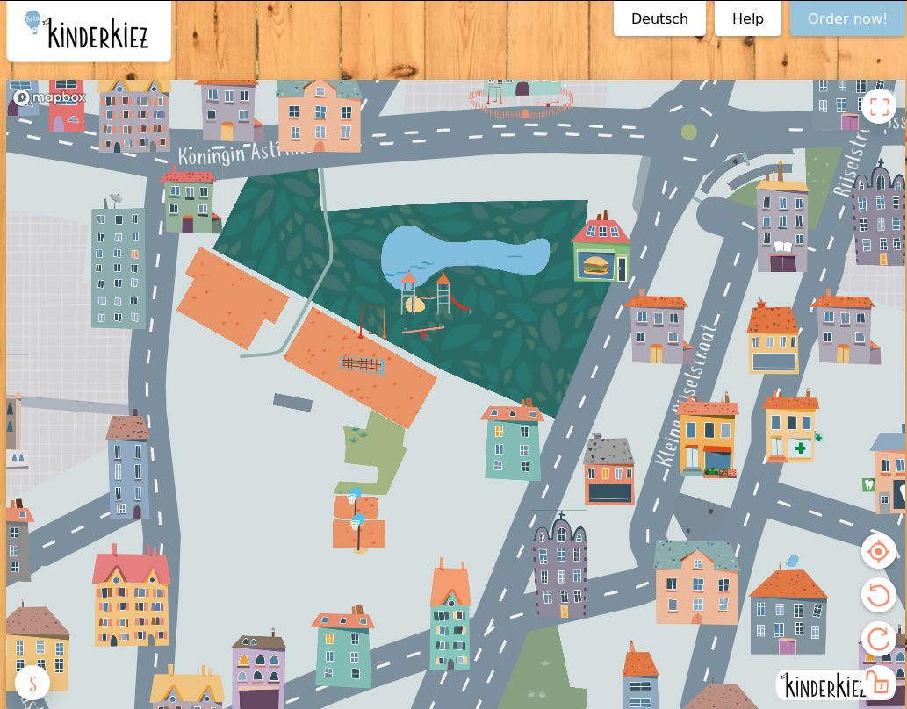
https://kinderkiez.net

Slide 55
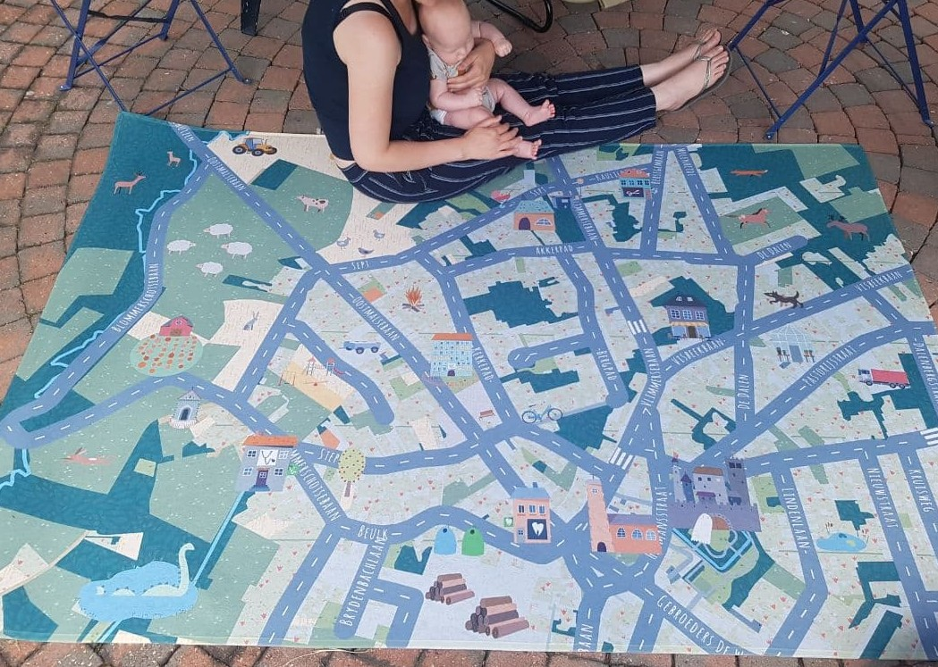

https://kinderkiez.net

Slide 56
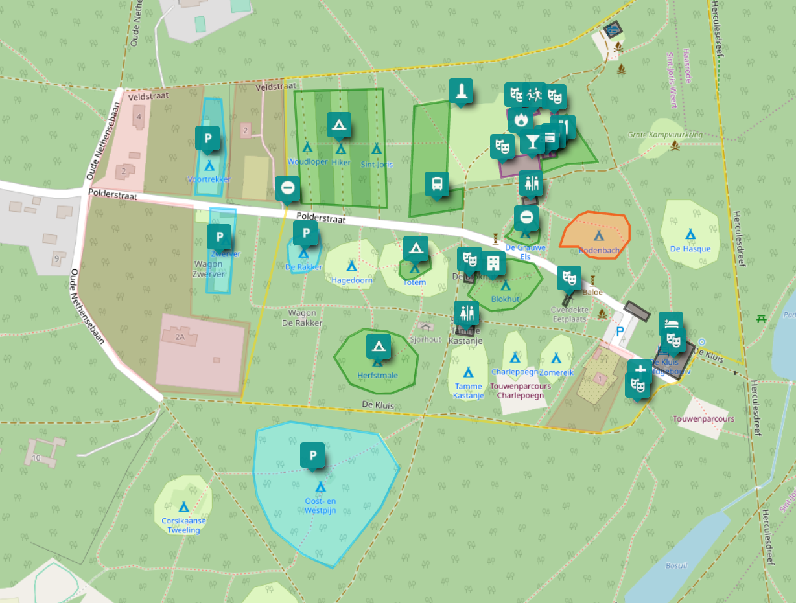
Umap.openstreetmap.fr
Ideal to add geodata not suited for OSM itself
  Preparing an event
  Planning an outing
  ...

Slide 57
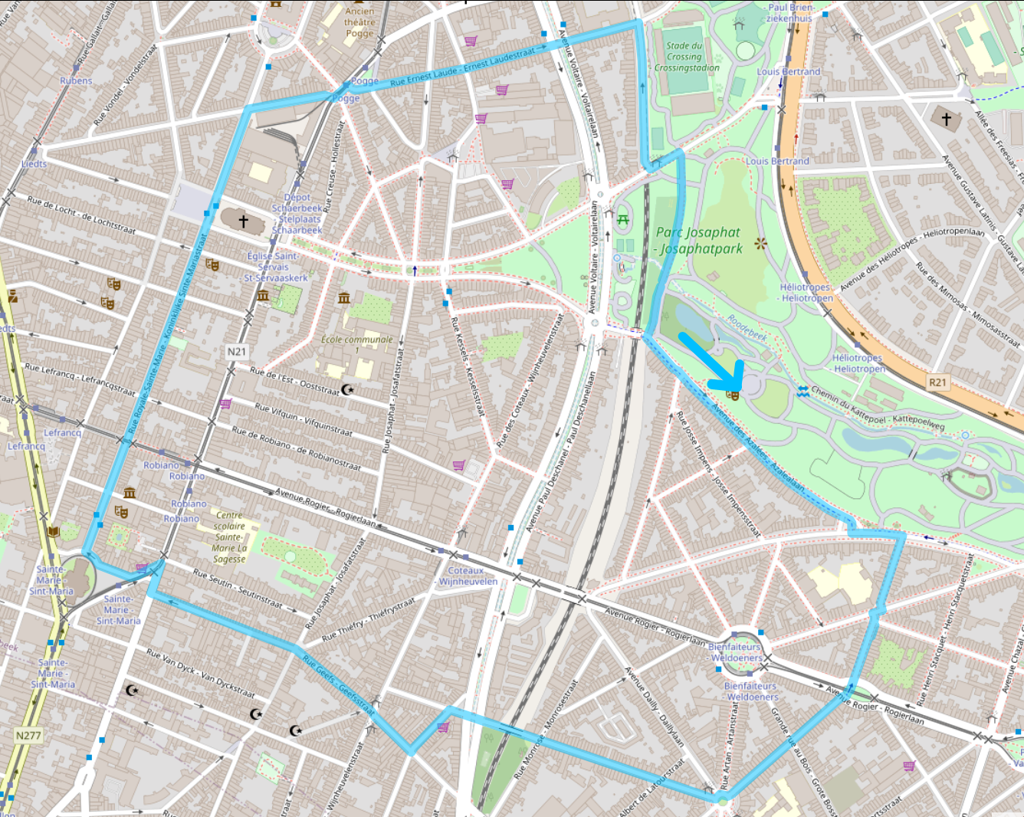
UMap

Slide 58

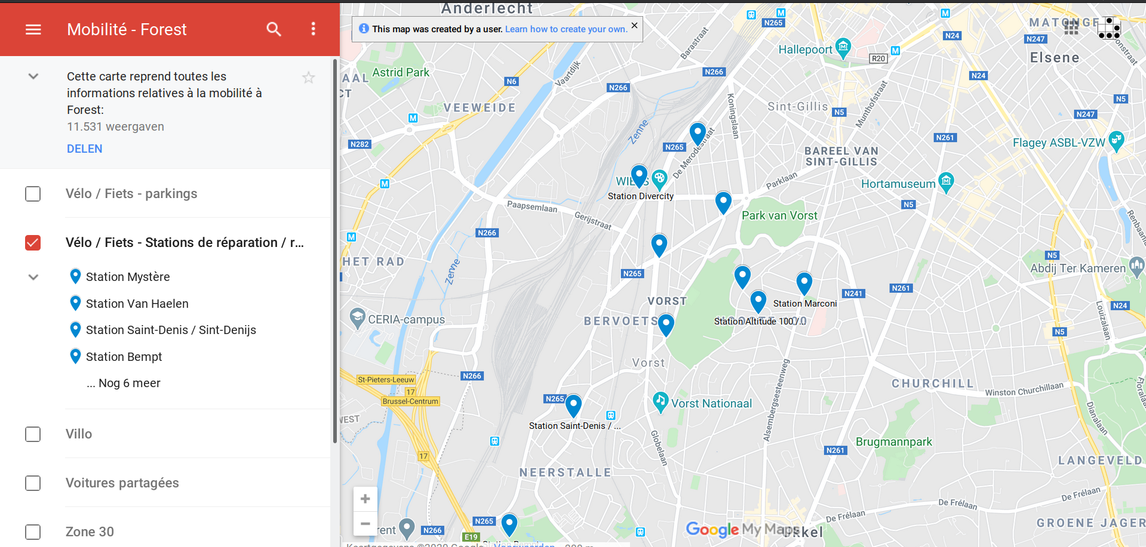
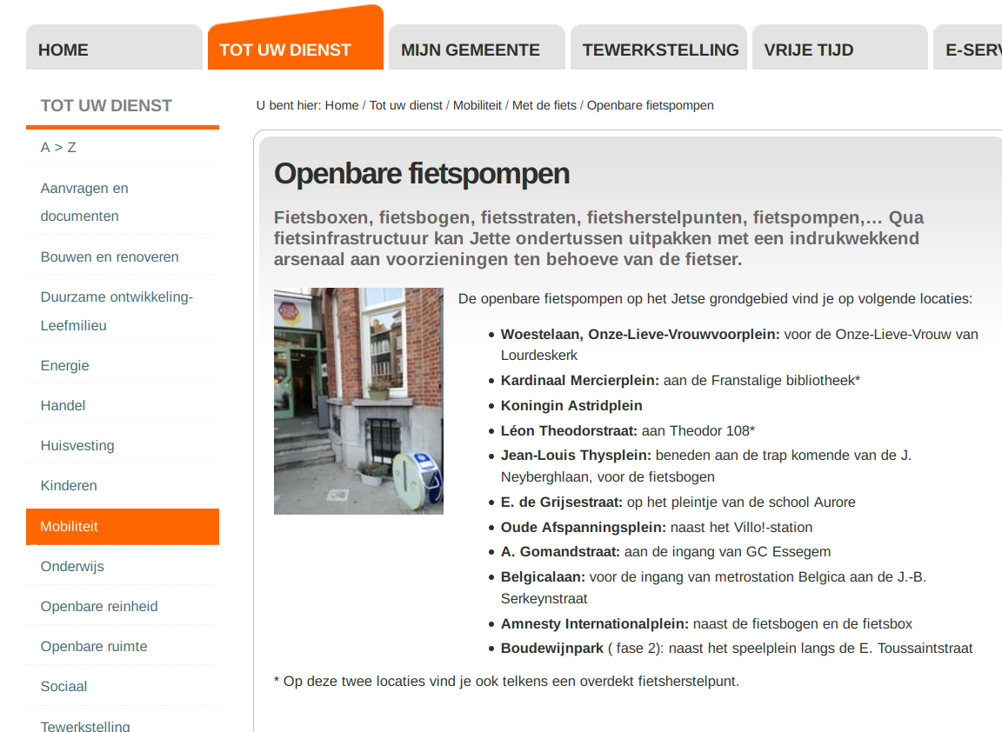
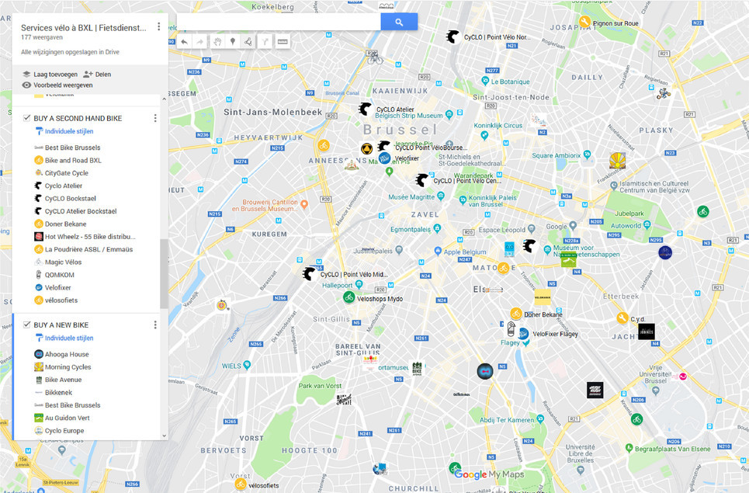

Slide 59
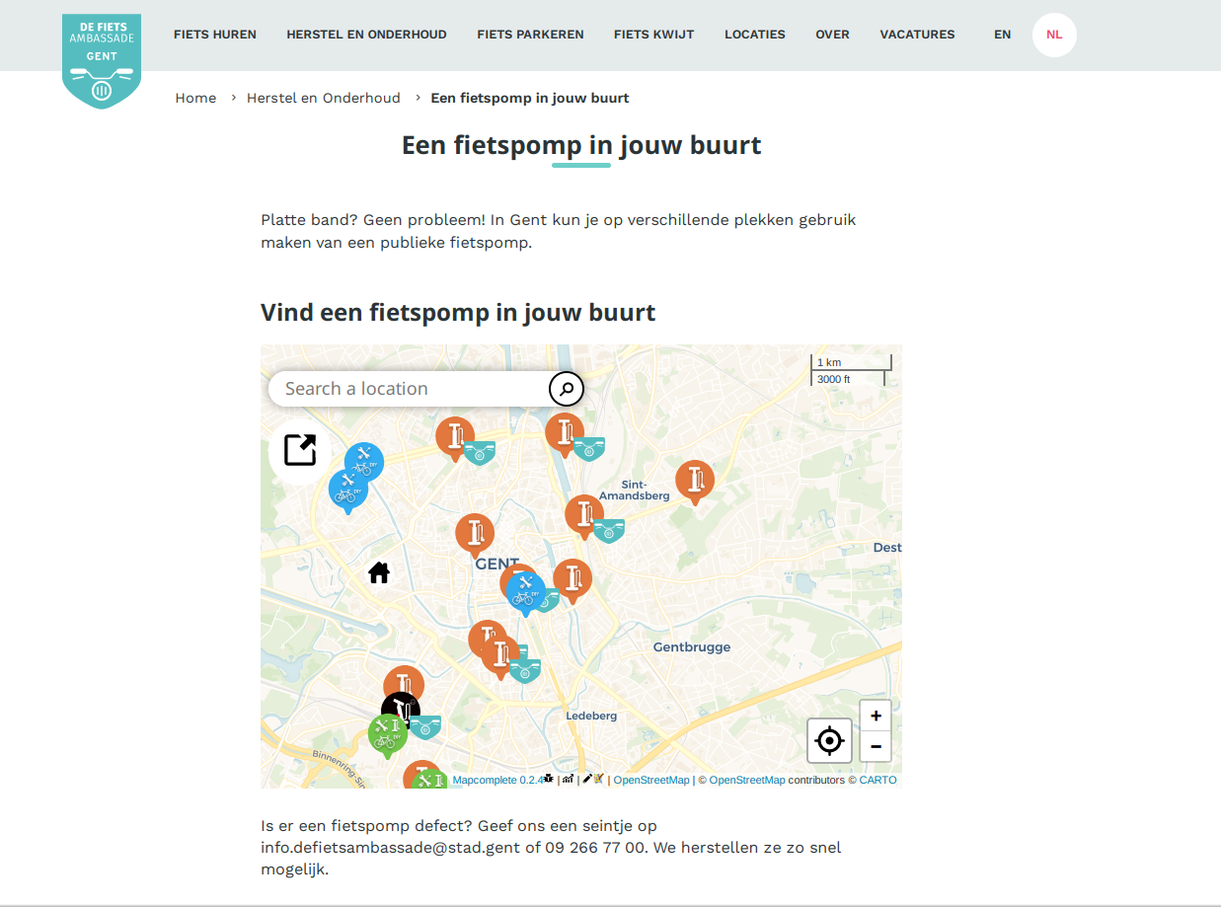

Slide 60
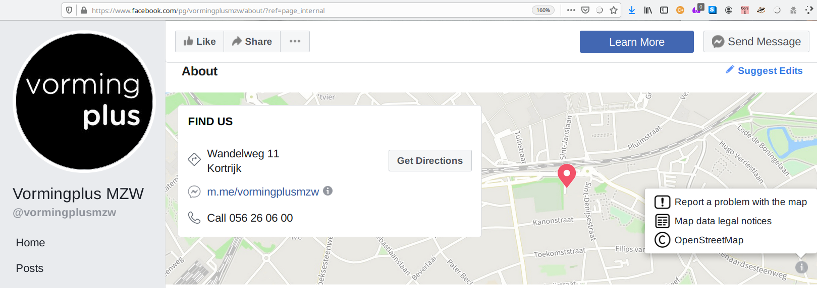


Slide 61
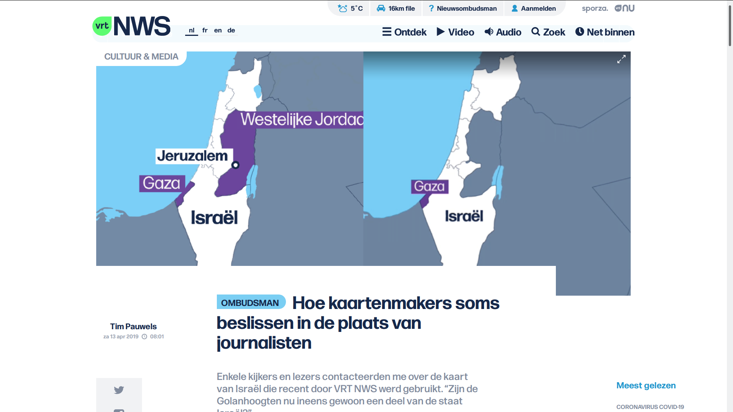

Slide 62

Szell, M. (2018). Crowdsourced Quantification and Visualization of Urban Mobility Space Inequality. Urban Planning, 3(1), 1-20. doi:http://dx.doi.org/10.17645/up.v3i1.1209

Slide 63
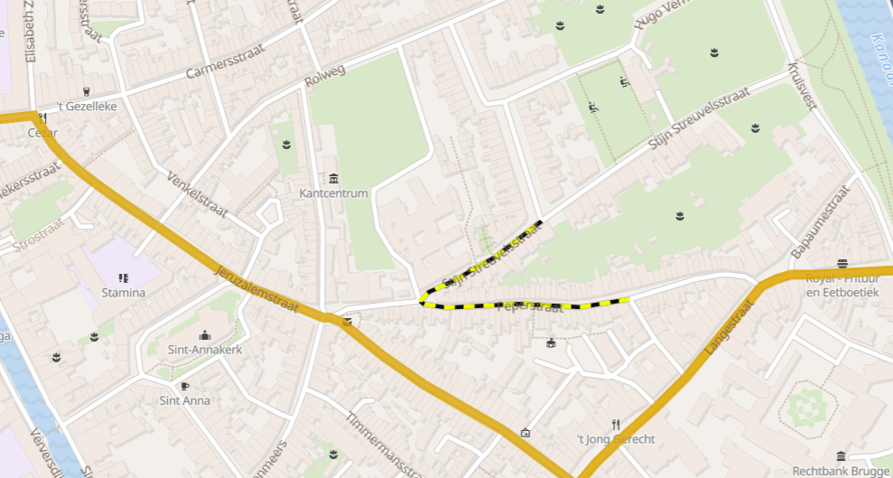
Mobility analysis sandbox to experiment
Disclaimer:
this is slide is shameless self-promotion
for anyways.eu

Slide 64
Custom queries: overpass-turbo.eu

Slide 65
Getting specific data
Where are all the chimneys/hairdressers/roads with cobblestone/… in … ?
Ask overpass!

Slide 66
Overpass
Easily query the OSM-database
Can be used to create an on-the-fly, automatically up-to-date map*
Lots of complicated features
10’000 queries/(day*project)
(* often a few minutes behind osm.org)

Slide 67
Overpass-turbo.eu
Where are all the chimneys/hairdressers/roads with cobblestone/… in … ?
Ask overpass!

Slide 68
Using overpass-turbo
Lookup the tag(s) on wiki.osm.org
Go to overpass-turbo.eu
Click ‘wizard’
Enter your query
  highway=* & surface=*
  natural=water | water=*
  natural=tree in Brussels
  …
Click ‘Build and run query’

Slide 69
Using overpass-turbo
Users of DuckDuckGo:
!wosm bicycle parking
!otw amenity=bicycle_parking
Done

Slide 70
Using overpass-turbo
Click ‘export’ to save as
GeoJson, GPX, XML, …
… or to get a URI to query in another app
  (such as JS to pass it to Leaflet)
Click ‘share’ to share with others

Slide 71

What is
OpenStreetMap
NOT?

Slide 72
When did you last use a map?
Which map was it?
Why?
How much did you pay to use it?

Slide 73
Price of maintaining a map
Google Maps costs around
  ??? dollar/year

Slide 74
Price of maintaining a map
Google Maps costs around
  1 ‘000’000’000 dollar/year
  (This number is a rumor, no official sources exist)

Slide 75
Price of maintaining a map
Google Maps costs around
  1 billion dollar/year
  (This number is a rumor, no official sources exist)

Slide 76
Price of maintaining a map
Google Maps costs around
  1 billion dollar/year
  (This number is a rumor, no official sources exist)
Buying and creating satellite and map data
Google Streetview costs $200 ‘till $1150/km
Google bought Waze for 1.1 billion dollar

Slide 77
Price of maintaining a map
Similar amounts for other services
Google bought Waze for 1.1 billion dollar
Nokia bought Navteq for 8 billion dollar
and ‘burns’ 1 billion a year
Apple maps burns around 1 billion dollar/year
http://www.asymco.com/2012/12/18/how-much-to-maps-cost-and-what-are-they-worth/
http://www.asymco.com/2012/12/18/how-much-to-maps-cost-and-what-are-they-worth/

Slide 78

How much did you pay?
There is no such thing as free lunch

Slide 79


Slide 80
Notes:
Why are these shown? Why not a very recognizable spot? Such as the stations?

Slide 81

Google Maps is advertising
Google makes money by
placing ads on the map
giving some venues more priority in search
No incentive to map poor countries
“Google Maps only works within 100 miles of a starbucks”
Notes:
Who remembers this

Slide 82

Google Maps is tracking
Google tracks your searches and location through maps,
under the guise of features
“Share your location”, “Find my phone”, “Where am I?”
Very valuable information
Better ads
How effective is an ad pin?
...
Notes:
Who remembers this

Slide 83
… but
Google Maps does have more information
on shops and businesses for now
because everyone searches them there
(It’s even worse – a shop not on Google
“does not exist”)
but this is changing!

Slide 84

OSM is catching up!
2007 2017

Slide 85
OSM is truly free
Free as in beer*
Free as in freedom
However, if you can afford it, donate back
Money for the server
Data – contribute yourself
Love – use it on the road and in your projects
Users – spread the word
*There are commercial, paid solutions too for heavy map users
However, as there are multiple players, it is affordable

Slide 86
What is
OpenStreetMap?

Slide 87
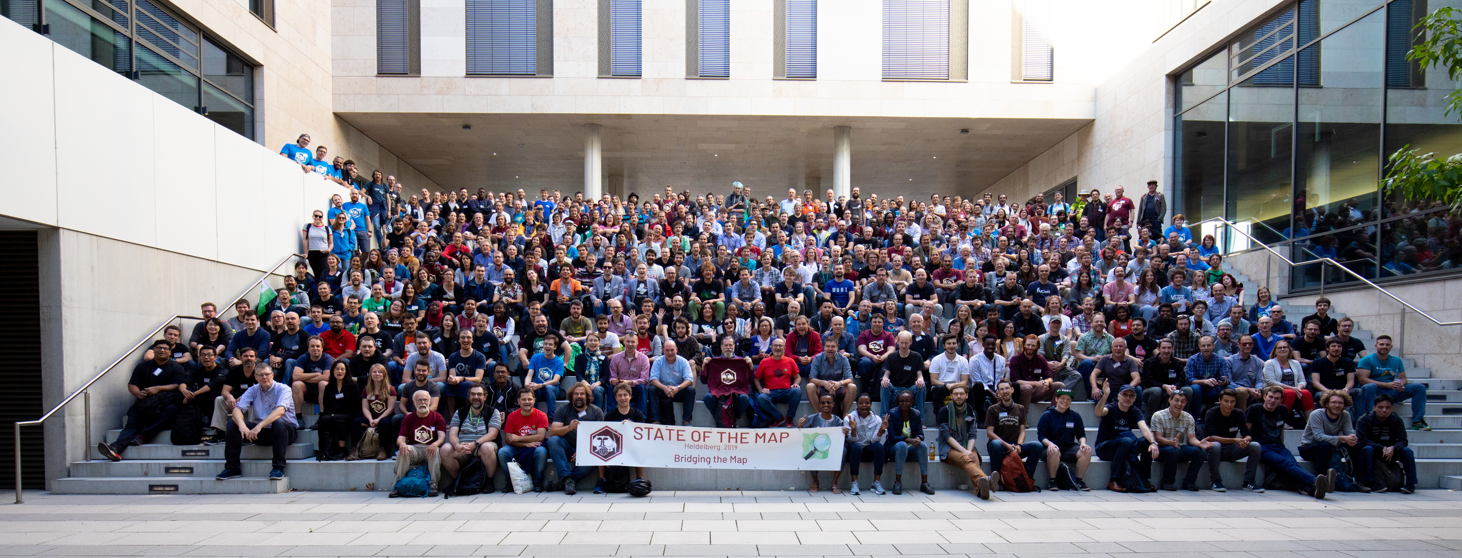
Community

Slide 88

The Belgian community does stuff
Osm.be
Find us on meetup.com
Talk to us on element.io (Matrix) (https://app.element.io/#/room/#osmbe:matrix.org)
Donate so we can buy 360° camera’s, stickers, vests, servers, …
Help our projects (map historical data, public bookcases, ...)

Slide 89
Working together on the most accurate, most detailed most up-to-date and most open global map

Slide 90
More resources
https://multimob.be/uploads/osm-handbook.pdf
https://switch2osm.org/

